Slide 1
Thank you for signing up to attend DASC Club 2022 AGM
Tuesday 17th November 7.30pm
About the Meeting
For most of the AGM, only the presenters will be able to speak. You will be asked to mute your microphone to prevent audio problems during the meeting.
If you would like to ask a question please type it in the ‘public chat' box or type to request to speak. We will endeavour to answer your questions as best we can as we go through the meeting.
Minutes will be taken and issued post call.
If you have not registered to attend the meeting but have joined the meeting don’t’ worry you will be registered as attended in the minutes.

Slide 2
Agenda
The business for an AGM shall include:
President’s introduction
2. Apologies for absence
3. Approval of minutes from 16th November 2021 AGM & matters arising
2022 Annual Report
5. Financial Report & Approval of Annual Accounts
Appointment of Auditors / Independent Examiners
Motions & Proposals
Appointment of President and Vice President
Election of Management Committee Members
Approval of the Nomination of Swimmers Representative
Other relevant business

Slide 3
President’s Introduction

Slide 4
Welcome and thank you for joining our 2022 AGM.
What a great year of a return to a more ‘normal’ swim calendar.
We have also entered teams for both the Novice Gala and Fife Leagues and our swimmers have achieved over 150 personal best times at these events which makes us all very proud. Thank you to everyone who made it possible.
We said a sad goodbye to Brenda and Mike Tate who retired from coaching in June 2022. Mike and Brenda have held most of the positions in our club over the years before becoming squad coaches. It was a huge loss to our club, and I am glad that we had honoured their service with Lifetime Membership to the Club prior to the global pandemic.

Slide 5
Our Gold squad have been to Stirling University 50m pool and Royal Commonwealth Pool for a diving session. They really enjoyed both sessions and it is something we would like to continue for both the Silver and Gold squads to help their times in some of the distance events and is a different type of training. This was paid for from a ring fenced grant which we got prior to COVID for swimmer retention. Unfortunately there is a huge drop off in the sport at around the age of 14.
Going forward we are looking forward to having a SWIM SATURDAY once a month in a long course pool or at Michael Woods for some alternative training.
I am very proud that we have continued to provide swimming opportunities for young carers (in conjunction with Fife Young Carers). This has been a vital source of respite for the young people.
We have welcomed three Ukrainian boys into our club, and I hope they enjoy their swimming again and make some new friends.
In addition to On Deck, after feedback received from parents/carers, we reopened a Facebook page to share information posted On Deck as well as a platform for parents/carers to comment on posts.

Slide 6
I would also like to encourage new members to come forward and join the committee to help with the running of the club and bring new ideas to the table. The club simply cannot run without this support. We all have other commitments but when shared the tasks are not onerous. I would urge you to come forward and offer a small amount of your time.
If the Management Committee seems like too much please consider doing a job like running a weekly tuck shop at our club night or help for a one off event like the sprint gala so you have a date your job is done by.
As we move on the next screen shows attendances and apologies, this will be updated after the meeting and issued with the minutes.
2021 Minutes and 2022 AGM reports, along with supporting documents, were issued prior to this meeting. If you have not already done so I would urge you to read the documents which contain important Club information.
Thank you

Slide 7
Attendance & Apologies

Slide 8
AGM Register
Undeclared:
Cuddy – Bronze Dev
Denholm – Dolphins & Bronze Dev
Donnelly – Dolphins
Drummond – Bronze
Gilfillan – Bronze Dev
Glass – Silver
Halliday – Bronze Dev
Hamilton – Masters
Hunt – Dolphins & Bronze Dev
Hunter – Silver Dev
Innes – Silver Dev
Jobson – Silver Dev
Lowe – Dolphins
Maison – Dolphins
Miller-Duff – Dolphins
Mitchell-Henry – Gold
Reid – Dolphins
Rennie – Bronze Dev
Robertson – Bronze
Ryan – Dolphins & Bronze Dev
Sanroman – Dolphins
Smith – Silver
Sneddon – Bronze Dev
Still – Silver Dev
Tate – Masters
Thomson – Gold
Tsirogianni – Gold
Webster – Bronze Dev & Silver Dev
Those attending
Matthew Bond
Nicki Daw
Andrew & Caron Aird
Leanne Farah
John Norrie
Linda Fletcher
Gareth Hewie
Mairi Jiminez
Karen Kemp
Ruth Lockier
Suzi Miller
Debbie Moss
Grant Spalding
Andrew Ross
Jemma Shaw
Laura Sinclair
Deny Spalding
Hazel Talbot
Meg Buchanan
Sarah Purcell
Gillian Wilson
James Daw
Apologies
The Barclays
The Fieldings
The Forkers
The Gilchrists
The Martins
The McGowans
Ritchie Metcalfe
Ann Farrell
Anita Jeffries
Phil Smithard
Amanda McLuckie
Kate Hogarth
Penny Wadham
Undeclared:
Adams – Dolphins
Aitken - Dolphins
Andrew – Gold
Bayne – Silver Dev
Belford – Bronze & Gold
Bowler – Gold
Brand – Silver
Bringhurst – Silver
Brisbane – Platinum
Cameron – Bronze Dev
Christie – Gold
Clark – Bronze Dev

Slide 9
Approval of 2020 minutes and matters arising

Slide 10
16th November 2021 minutes were issued prior to today’s meeting.
Matters arising:
Securing additional Pool time continues to be a key priority for the Club
Constitutional and Bye-Laws amend to be implemented – complete
2021 Club Championships and Presentation night to be delayed and take place in 2022 – complete
Independent Auditor role to be filled – complete, Matthew Bond
Secretary role to be filled – complete, Nicki Daw
WPO role to be filled – complete, Claire Thornton and then Hazel Talbot
Membership Secretary role to be filled – complete, Leanne Farah and Debbie Moss
Appointment of Gala Secretary – complete, Mairi Jimenez
Appointment of Swimmers Representative – complete, Aimee Wilson
Implementation of Club Development Plan initiatives – ongoing
No questions or objections have been raised.
Approver: Ruth Lockier
Seconder: Meg Buchanan

Slide 11
2022 Annual Report

Slide 12
Annual Report was issued in advance of today meeting to all members of the Club.
If you have not had the opportunity to read this I recommend that you take time to do so as it contains key information about the club.
I would like to draw your attention to the following key points
Membership strong with 98 swimmers and a waiting list
Amendments to constitution and bye-laws are proposed.
Vice President role vacant, joint Gala Secretary role vacant, joint Well-being and Protection Officer role vacant general committee members vacant.
Swimmers representative position vacant.
No outstanding Well-being and Protection issues to report
Bonus Ball continues to be drawn monthly, Numbers available. Looking to get back to fundraising in the coming year.
Club Kit can be ordered from Meg Buchanan or via link on DASC website.

Slide 13
Continuation of key points;
Lots more competitions took place with Fife League & Novice League.
DASC hosted their own Sprint Gala inviting other clubs and generating £2.5k profit for the Club, however a deficit was reported this year, requiring an increase in club fees, attraction of more grants and where necessary a reduction in spending
2021 and 2022 Club Championships and Graceful Swim took place
Team Unify / On Deck primary communication channel for the Club, supported with Facebook
Squads headed up by specific coaches
Flexible promotions aligned to swimmers development now in place.

Slide 14
Financial Report & Approval of annual accounts

Slide 15
Total receipts for the year were £30,198 and expenditure £34,202 resulting in a net deficit for the year of £2,005. The key drivers of this deficit are:
Fordell Fund Day: -£1,523
IT costs: -£1,519
Xmas gifts: -£1,430
SASA East District Fees: -£762
Coaches/Helpers training fees: -£737
The majority of the income is from monthly fees which is required to cover the cost of the following:
Pool Hire
East District Fees
Social Events (i.e., Awards Night, Trophies & Medals, and Xmas Gifts)
IT Costs (i.e., OnDeck App, Email Accounts & Website Fees)
SASA Non-Swimmer Fees (i.e., Committee Members, Coaches & Helpers)
The DASC Junior Sprint Gala was held this year and a healthy surplus of £2,542 was raised from this event. Despite this, the club made an overall deficit of £2,005. If the club had not been not able to hold the Junior Sprint Gala (due to lack of demand/entries), the overall deficit for 2021/2022 would have been £4,547.

Slide 16
The Committee have determined that monthly swim fees will be increased by £2 for the next financial year:
• Dolphins £16
• Bronze Development £16
• Bronze £19
• Silver Development £27
• Silver £27
• Gold £32
• Platinum £27
If this causes any issues for Swimming families, please contact Gareth confidentially at treasurer@dasc-swim.co.uk as we do not want anyone to miss out on swimming and can support families where necessary.
We will also be applying for more grants to help support some of our community initiatives

Slide 17
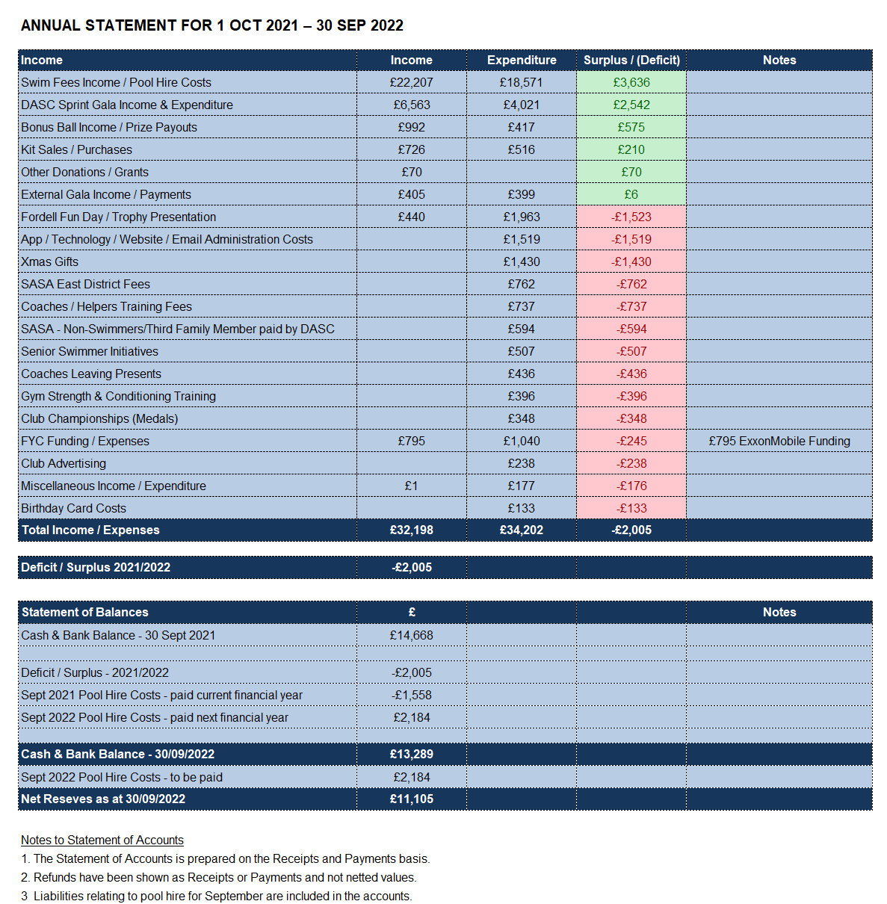

Slide 18
Appointment of Auditors / Independent Examiners
Matthew Bond
Proposed; Nicki Daw
Seconded; Ruth Lockier

Slide 19
Motions & Proposals

Slide 20
Scottish Amateur Swimming Association (SASA) Constitution Amends
These are mandatory amends from SASA to keep all Swimming Clubs under similar governance. There are too many to outline here but were all documented in the Constitution Changes 2022 document sent out ahead of the AGM. The only optional one is this one:
Current C5.1.2:
C5.1.2 Attendance
All Adult members, adult representatives of Junior members, Life members and Honorary members are entitled to attend, take part and vote unless specifically excluded from doing so by the Club’s Constitution.
OPTIONAL Amend to C5.1.2:
C5.1.2 Attendance
All Adult and Life Members are entitled to attend, take part and vote unless specifically excluded from doing so by the Club’s Constitution.
A Parent/Guardian, who is not a Club Member, is entitled to attend and take part on behalf of a Junior Member.
Proposed: Nicki Daw
Seconded: Gillian Wilson

Slide 21
DASC Constitution Amendments
Current:
C3.5 A member wishing to resign from the Club shall inform the Secretary in writing
Proposed:
C3.5 A member wishing to resign from the Club shall inform the Membership secretary, Treasurer and Head Coach via email.
Proposed: Gillian Wilson
Seconded: Nicki Daw
Current:
C5.1.4 Quorum The quorum at General Meetings shall be two Officers of the Club plus 10 members eligible to vote.
Proposed:
C5.1.4 Quorum The quorum at General Meetings shall be two Officers of the Club plus 7 members eligible to vote.
Proposed: Gillian Wilson
Seconded: Nicki Daw

Slide 22
DASC By-Law Amendments
BL1.5 Management Committee
BL1.5.1 The management committee shall comprise of the Officers of the club (as defined in BL1.2), seven other Adult Members and the Swimmers representative. The ex-officio members of the Management Committee consist of the Wellbeing & protection officer (where not one of the elected adult members), Meet Secretary, the Squad Coaches, x2 Club Captains.
BL1.5.2 The term of office for President, Vice President, Secretary and Treasurer shall be three years, one retiring annually in rotation.
BL1.5.3 The term of office for the Adult Committee Members shall be two years, half retiring annually.
Propose to remove retiring annually from both BL1.5.2 and BL1.5.3 this is to ensure continuity and knowledge of Scottish Swimming and running a swimming club being able to be passed on to new members of the committee and officers of the club. Re-election to the role will be required on an annual basis at AGM.
Proposed: Nicki Daw
Seconded: Karen Kemp

Slide 23
DASC Club Regulation Updates
The following updates have been approved by the management committee.
Optional Regulations / Policies in place (with Scottish Swimming versions)
Photographic and Video Equipment
Team Manager Policy
Hard Ship Policy
New Swimmer entry procedure
Mobile Phone Policy.

Slide 24
DASC Club Regulation Updates
R 9.2 - Speed Swimming Competition
R 9.2.1
Shall be a series of events as follows for the listed age groupings:-
Age Group Butterfly Back Breast Free Ind. Medley
Over 16 50 100 100 100 4 x 25
16 & Under 50 100 100 100 4 x 25
14 & Under 50 100 100 100 4 x 25
12 & Under 50 100 100 100 4 x 25
10 & Under 25 50 50 50 --
8 & Under 25 25 25 25 --
Note – Distances may be yards or metres.
Butterfly to be amended to 50m to encourage participation in our annual club championships.

Slide 25
DASC Club Regulation Updates
R 9.3 - Graceful Swim Competition
R 9.3.1
There will be separate competitions for female and male swimmers with age groups split as follows:
10 and under
12 and under
13 and above
Add in 10 and under in the Graceful Swim Competition but recognise that entrants must come from bronze squad and above. This is not in the Butterfly. Propose these are called the Steven Fielding Boys and Anita Jefferies for the Girls to honour both coaches for their volunteering contribution over the years.
Add in a Trophy/Shield for the Most Improved Beginner. To be decided by coaches for a beginner who has improved the most in stroke and technique throughout the year. Propose to name this Brenda Tate Trophy/Shield to recognise Brenda’s years of volunteering with our Dolphin squad.
Add in a Trophy/Shield for Cannon Club Relay Competition. To be held at our Club Championships. Swimmers from all squads will be selected into teams with coaches/club captains as lead, swimmers swim 25m and the team can decide which order the swimmers swim in. Propose to name this the Ken Vogel Trophy/Shield

Slide 26
Appointment of President & Vice President
Position | 2020/21 Incumbant | 2021/22 Nominee | Proposer | Seconder
POSITIONS
President | Gillian Wilson | Gillian Wilson | Hazel Talbot | Mairi Jimenez
Vice President | VACANT | VACANT | Remains vacant

Slide 27
Election of Officers & Management Committee Members

Slide 28
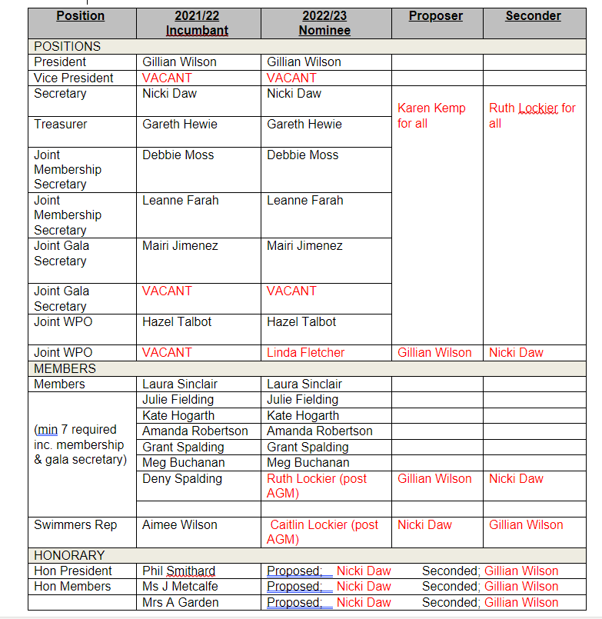
Election of Officers & Management Committee Members

Slide 29
Notes from election of Officers and Committee Members
Ruth Lockier - happy to train on the Gala system HyTek, and monitor emails in the gala as well as help with attending diving sessions and other sessions where coaches don’t have to go, the parents just run it.

Slide 30
Approval of the Nomination of Swimmers Representative
BL1.5.12 The swimmer’s representative (minimum age 14) shall be elected by the swimming members of Gold and Platinum squads and must be a member of the Club on 30th June prior to the AGM. The AGM approve the appointment.
Current role holder Aimee Wilson is stepping down and this position has become vacant.
Swimmers Rep – Caitlin Lockier – announced at Presentation Night

Slide 31
Other relevant business

Slide 32

DASC Mission statement & vision
MISSION
Dunfermline Amateur Swimming Club (DASC) is a friendly and inclusive family club working to give all swimmers the opportunity to enjoy and develop their swimming.
VISION
To promote the joy of swimming recreationally and competitively to all club members, at all levels.

Slide 33
DASC values
COMMUNITY
ENJOYMENT
TEAMWORK
Inclusive
Friendly
Positive
Creative
Socially Responsible
Training
Learning
Being Together
Competitions
Encouraging
Commitment
Team Spirit
Co-operative
Motivational
Safe

Slide 34


Club Development plan
Plan based on Scottish Swimming 6 key categories critical to the delivery of quality club environments.

Slide 35
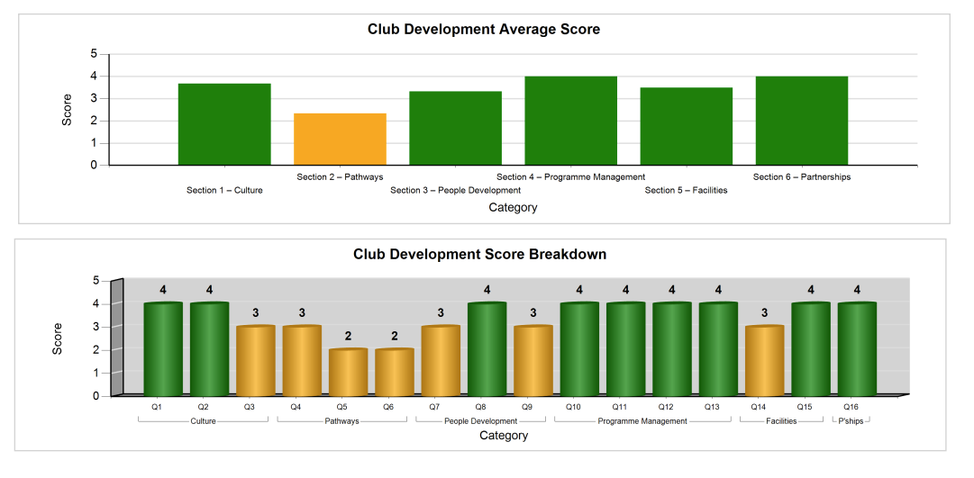
Club Development plan
Answering 16 target questions, this produced a scoring and RAG status against each of the 6 categories along with recommendations for improvement.

Slide 36
Club Development plan
2021-2022 initiatives.
Activities to encourage retention of senior swimmers - Stirling, RCP Diving session.
Develop a strategy for athlete pathway.
Strengthening partnerships with community, FSLT and other facility providers so the club can grow in future years.
2022-2023 planned initiatives
Continued execution of items 1-3 above
Increased focus on competitiveness & performance, to run alongside our strength of inclusivity.
Development plan for all volunteering roles and succession planning for coaches.

Slide 37
DASC Communication
Team Unify / On Deck
Ensure TEAMFEED is checked regularly
You can PIN any post to the top of your own TEAMFEED for ease of reference
Emails can be replied to direct from message
To respond to an event click on the link and rsvp
Galas will be announced in the events section, it is your responsibility to respond
Website
Currently working with developers to ensure DASC website is easily located via search engines
Will require to log in to view personal and member only information
Same password as On Deck App
      Facebook
Secondary to On Deck, admin will pull info from Team Feed.
Ability to comment if required on post.

Slide 38
Young Volunteers Programme
Opportunities exist within Scottish Swimming for young people to attend various workshops and residentials. Please check the Scottish Swimming Website and Social Media channels regularly. Should your young person wish to be involved please enrol via Scottish Swimming website.
Many thanks to Lily Purcell and Aimee Wilson who organised Fordell Firs after attending Young Leaders Residential last year.

Slide 39

Buy your Bonus Balls !!!
Only £2 per month
Available Numbers
8
9
10
14
15
18
19
20
21
24
25
28
31
34
36
37
45
46
48
50
51
57
Email treasurer@dasc-swim.co.uk if you would like to purchase any of these available bonus balls, just add £2 per ball to your monthly fees

Slide 40
AOB and Questions?
Last collection for hamper donations this Friday 18th November 2022. Many thanks to those who have donated to the Christmas hamper and thank you to Karen Kemp who is collating the items and making up the hamper.
LOG back into Zoom if you do not have access to on deck and Gillian will give you video demonstration.
Can resend email and password setting.

Slide 41
Update from Honorary President
I would wish to record my sincere thanks to all those involved in running the club, both on and off the poolside, ensuring our commitment to the Young People of today is alive and well. I am a great supporter of the help the Club is providing to certain youngsters in the club and by all feedback, it is greatly appreciated. We must continue with this stream.
I have recently committed to supporting the Monday evening session and can say I am much invigorated by doing so, being able help Steve out and with Ceitidh's ever-presence, to take on the newly arrived Dolphins. I have little experience poolside of this level of development, so it is proving a massive learning process for me and Ceitidh's advice and help has been instrumental in our sessions and what current practice is.
I wish you well at the meeting and look forward to 2023, our 75th anniversary as a club
Phil Smithard

Slide 42
Nicki Daw thanked Gillian Wilson for all her tireless work as President and said the Club is immensely lucky to have someone as dedicated and passionate as Gillian at the helm. It would not be the dynamic Club that it is if it weren’t for Gillian’s energy and enthusiasm.

Slide 43
CLOSE
Thank you to all of our speakers today
Any further questions?
Any additional business to raise?
Minutes and DASC Club Development Plan will be circulated from today’s meeting.
See you all in person at the Presentation Night on Friday 25th November 2022.

Slide 44
Thank you for your
attendance at the AGM
Stay safe and well

Slide 45
On Deck Walkthrough – Log Back IN to Zoom, any questions, examples of event acceptance etc..
Gillian provided a live demonstration to show how to use On Deck effectively and where to find key information
We are aware Teamfeed sometimes drops from individual accounts, this is a glitch which is being worked on. Meantime logging out then back into OnDeck should fix the issue
Gillian advised how to “pin” an important announcement such as the link to the club website to the top of your Teamfeed for easy future access. This facility is personalised by the user
The management committee have a different view of OnDeck dependant on their role. It is really important for members to provide feedback re issues if they are having any as the committee may not know about or see the problem due to their individual settings.

